Slide 2
Ant sorting
Menno Van Damme, Yari Van Laere

Slide 3
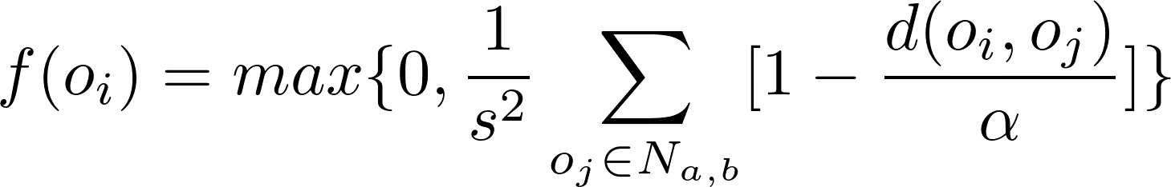
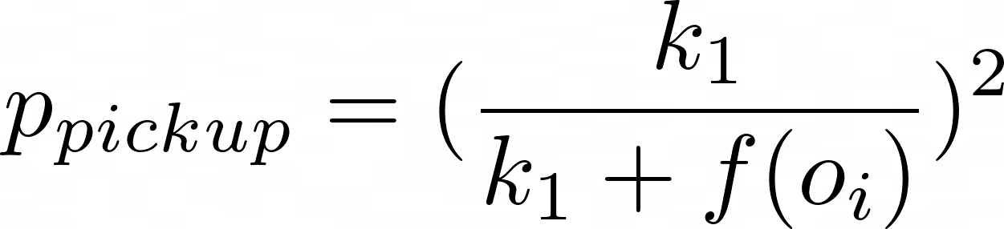
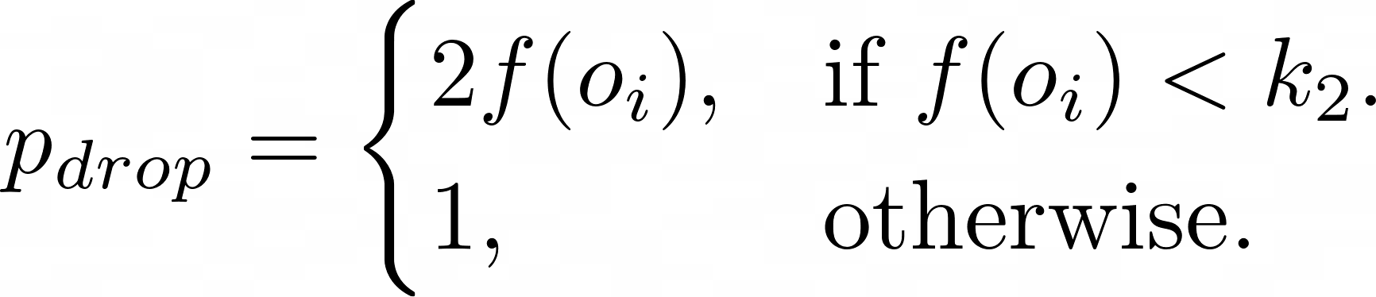
Lumer-faieta

Slide 4
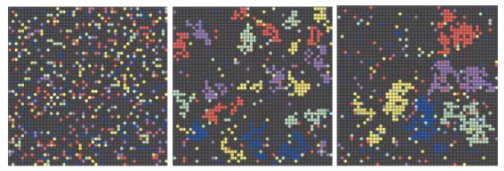
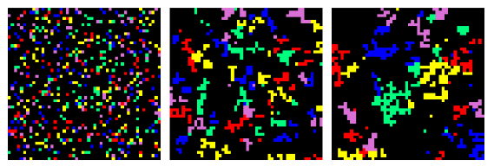
Results Lumer-Faieta
0
10 000
100 000

Slide 5
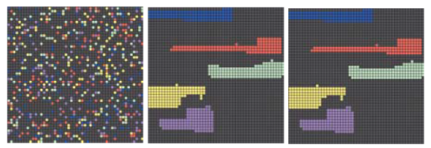
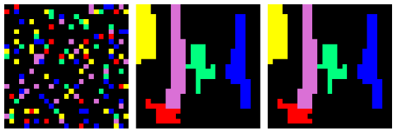
Results with clustering
0
10 000
100 000

Slide 6
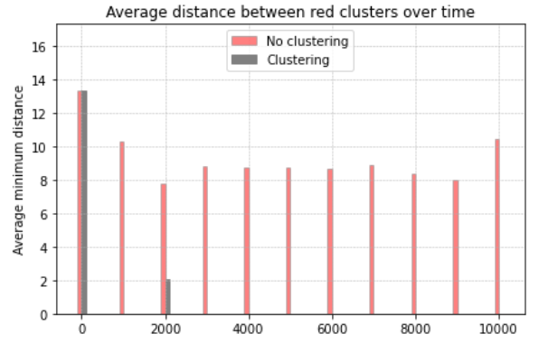
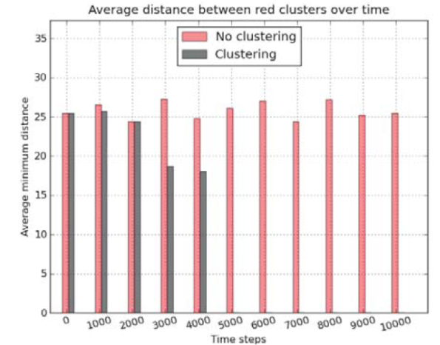
comparison

Slide 7
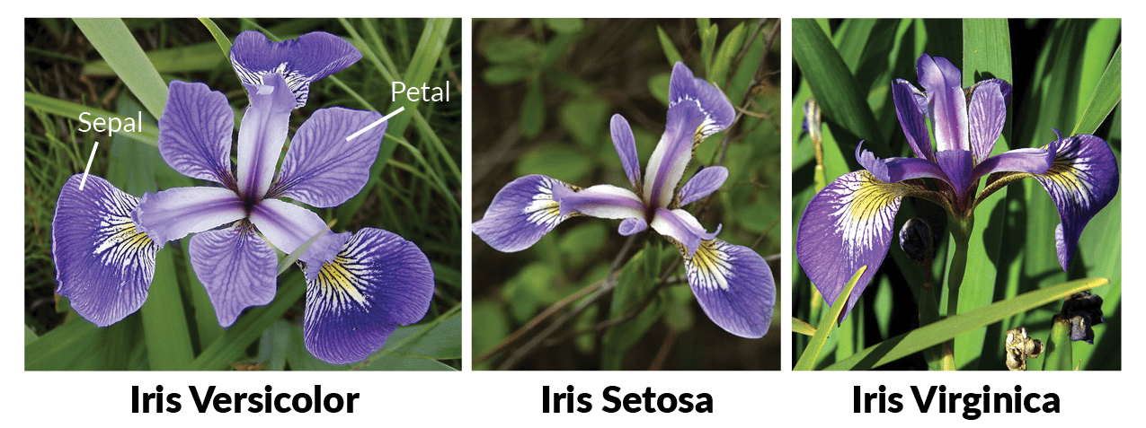
Continuous vector sorting

Slide 8
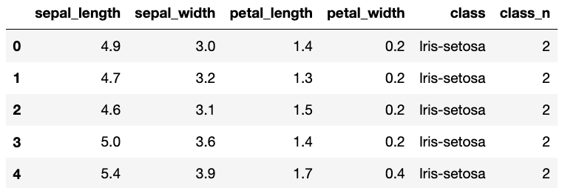
Continuous vector sorting
Notes:
Picture is a placeholder for now
The rows of the data table are the feature vectors used to sort the samples
Now that we’re working with continuous vectors there were 3 changes that need to be made: the way the dissimilarity is calculated, the value of alpha and the wlustering methid.

Slide 9
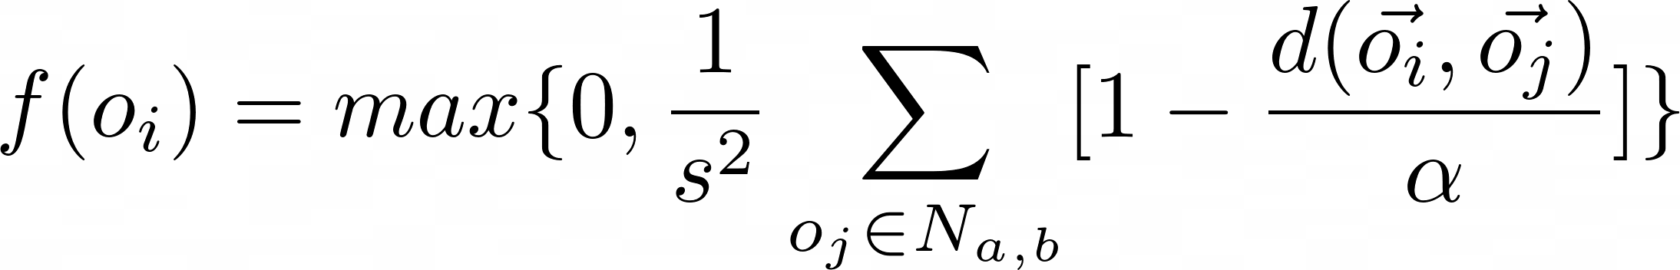
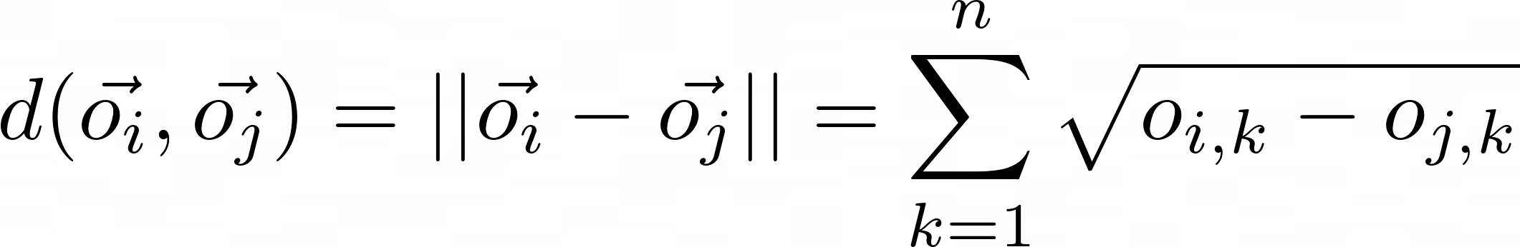
Dissimilarity
Notes:
Vectors were normalized, dissimilarity was normalized, stored in a dissimilarity matrix

Slide 10
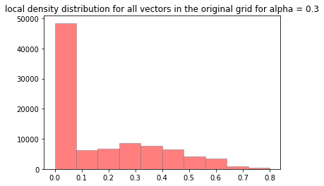
Alpha

Slide 11
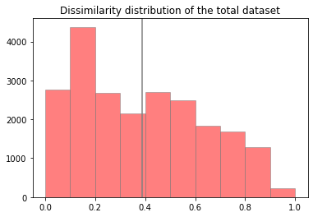
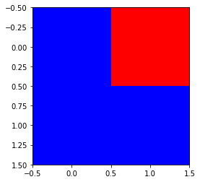
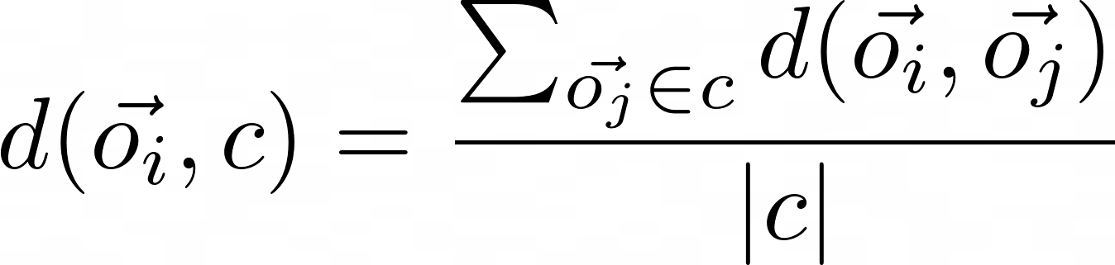
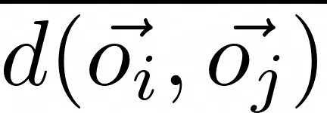
Clustering
Notes:
Lelijke slide :/

Slide 12

Clustering
Notes:
Lelijke slide :/

Slide 13
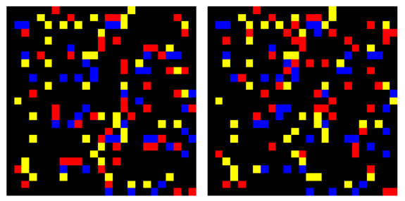
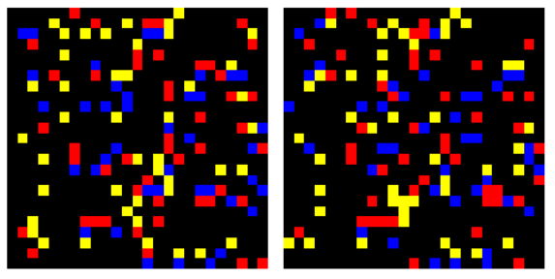
results
Lumer-Faieta without clustering
0
1 000 000
Lumer-Faieta with clustering
0
10 000

Slide 14
